Slide 1

Malware prediction: A supervised classification model
DATA602 – Spring 2022
Michael Ippolito
michael.ippolito@gmail.com

Slide 2
Malware Prediction: A Supervised Classification Model
Research Question
The Data
Modeling
Analysis & Conclusions

Slide 3
abstract
Computer networks connected to the Internet are prone to numerous types of attacks from malicious actors. Distinguishing between malicious and benign network traffic is typically complex and resource intensive. To aid in that effort, my project sought to create a supervised learning model to classify network traffic as either benign or one of 12 types of malware. I used a K-nearest neighbors (KNN) model to train intrusion detection data from the Canadian Institute for Cybersecurity, which included approximately 2.8 million observations spanning 84 variables. Principle component analysis (PCA) was used to reduce the data to five features. About 0.10% of the observations were discarded due to NaN or infinite values. The data was split into 70% training data, 30% validation data, and trained using five-fold cross-validation. A KNN model was trained using parameters nearest neighbors (3, 6, 9, or 12), leaf size (15 or 20), and weight (uniform or distance). Additionally, the number of PCA features was varied from two to five. In total, 320 model runs were executed over approximately 3.5 hours. Each run was scored using the macro average of F1 score (harmonic mean of precision and recall) and the mean of the area under the curve (AUC) of the receivers operating characteristics (ROC), using a one-versus-rest (OVR) strategy. The best model used 9 nearest neighbors, a leaf size of 15, distance-based weights, and five PCA features. The model performed well, with a macro mean F1 score of 0.82 and a mean AUC ROC OVR score of 0.962. Bot traffic was the most difficult to differentiate from benign traffic, and denial-of-service (DoS) Hulk traffic was the most prone to false positives. The model is generally suited for malware classification but is too slow to be used for real-time analysis without enhancement techniques such as downsampling or parallel processing.

Slide 4









Research question

Slide 5
Research question
Can network flow data be used to build a model to distinguish malicious traffic from benign traffic?

Slide 6


Netflow basics
Border router
Company network
metadata
(1:4 sample rate)
Sampled netflow data
Netflow collector

Slide 7
Exploratory data analysis
Network flow data – Canadian Institute for Cybersecurity (https://www.unb.ca/cic/datasets/ids-2017.html)
Source/destination IP address
Source/destination port number
Protocol (TCP, UDP, ICMP)
Packets/bytes sent/received
Packet flow rate
Flow duration
2,829,047 obs
84 features
13 label categories

Slide 8
Exploratory data analysis
# Column Dtype
--- ------ -----
0 flow_id object
1 srcip object
2 src_port int64
3 dstip object
4 dst_port int64
5 timestamp datetime64[ns]
6 flow_duration int64
7 tot_fwd_pkts int64
8 tot_bwd_pkts int64
9 tot_len_of_fwd_pkts float64
10 tot_len_of_bwd_pkts float64
11 fwd_pkt_len_max float64
12 fwd_pkt_len_min float64
13 fwd_pkt_len_mean float64
14 fwd_pkt_len_std float64
15 bwd_pkt_len_max float64
16 bwd_pkt_len_min float64
17 bwd_pkt_len_mean float64
18 bwd_pkt_len_std float64
19 flow_bps float64
20 flow_pps float64
21 flow_iat_mean float64
22 flow_iat_std float64
23 flow_iat_max float64
24 flow_iat_min float64
25 fwd_iat_tot float64
26 fwd_iat_mean float64
27 fwd_iat_std float64
28 fwd_iat_max float64
29 fwd_iat_min float64
30 bwd_iat_tot float64
31 bwd_iat_mean float64
# Column Dtype
--- ------ -----
32 bwd_iat_std float64
33 bwd_iat_max float64
34 bwd_iat_min float64
35 fwd_psh_flags int64
36 bwd_psh_flags int64
37 fwd_urg_flags int64
38 bwd_urg_flags int64
39 fwd_hdr_len int64
40 bwd_hdr_len int64
41 fwd_pps float64
42 bwd_pps float64
43 min_pkt_len float64
44 max_pkt_len float64
45 pkt_len_mean float64
46 pkt_len_std float64
47 pkt_len_var float64
48 fin_flag_ct int64
49 syn_flag_ct int64
50 rst_flag_ct int64
51 psh_flag_ct int64
52 ack_flag_ct int64
53 urg_flag_ct int64
54 cwe_flag_ct int64
55 ece_flag_ct int64
56 down_up_ratio float64
57 avg_pkt_sz float64
58 avg_fwd_seg_sz float64
59 avg_bwd_seg_sz float64
60 fwd_hdr_len_1 int64
61 fwd_avg_bytes_bulk int64
62 fwd_avg_pkts_bulk int64
63 fwd_avg_bulk_rate int64
# Column Dtype
--- ------ -----
64 bwd_avg_bytes_bulk int64
65 bwd_avg_pkts_bulk int64
66 bwd_avg_bulk_rate int64
67 subflow_fwd_pkts int64
68 subflow_fwd_bytes int64
69 subflow_bwd_pkts int64
70 subflow_bwd_bytes int64
71 init_win_bytes_fwd int64
72 init_win_bytes_bwd int64
73 act_data_pkt_fwd int64
74 min_seg_sz_fwd int64
75 active_mean float64
76 active_std float64
77 active_max float64
78 active_min float64
79 idle_mean float64
80 idle_std float64
81 idle_max float64
82 idle_min float64
83 label object
84 fn object
85 Mon uint8
86 Thu uint8
87 Tue uint8
88 Wed uint8
89 udp uint8

Slide 9
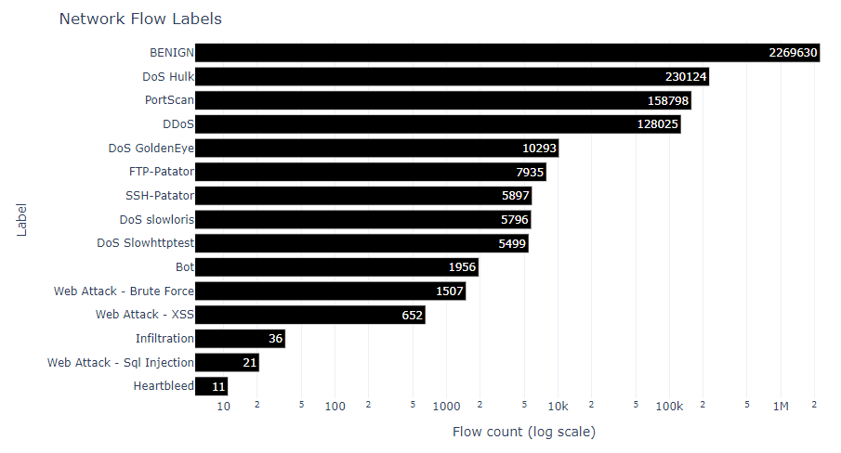
Exploratory data analysis

Slide 10
Data wrangling/tidying
Remove leading/trailing spaces in column names
Convert categorical variables to dummies:
Day of week
Protocol (TCP, UDP, ICMP)
Replace special characters
Drop rows with NaN or infinite values:
flow_bps (1509 rows)
flow_pps (1358 rows)
Observations: 2,829,047
Dropped: 2867 (0.10 %)

Slide 11
PCA
Filtered for quantitative variables
Used PCA from sklearn.decomposition
Started with 84 variables
Explained variance %
Rank Pct Cumul
---- ----- -----
0 0.629 0.629
1 0.108 0.738
2 0.105 0.843
3 0.079 0.923
4 0.040 0.963
5 0.020 0.983
6 0.007 0.991

Slide 12
modeling
Model selection:
KNN
SVM
Naïve Bayes
NN

Slide 13
KNN
KNeighborsClassifier (sklearn.neighbors)
n_neighbors: [3, 6, 9, 12]
weights: [‘uniform’, ‘distance’]
leaf_size: [15, 20]
train_test_split (sklearn.model_selection)
70% training / 30% validation
GridSearchCV (sklearn.model_section)
5-fold CV
features: [2..5] (explains 96.3% of variance)

Slide 14
ModeL RUNS
320 runs
3.5 hours
Scoring:
macro mean of F1 = harmonic mean of precision & recall
mean of ROC AUC (one-versus-rest)

Slide 15
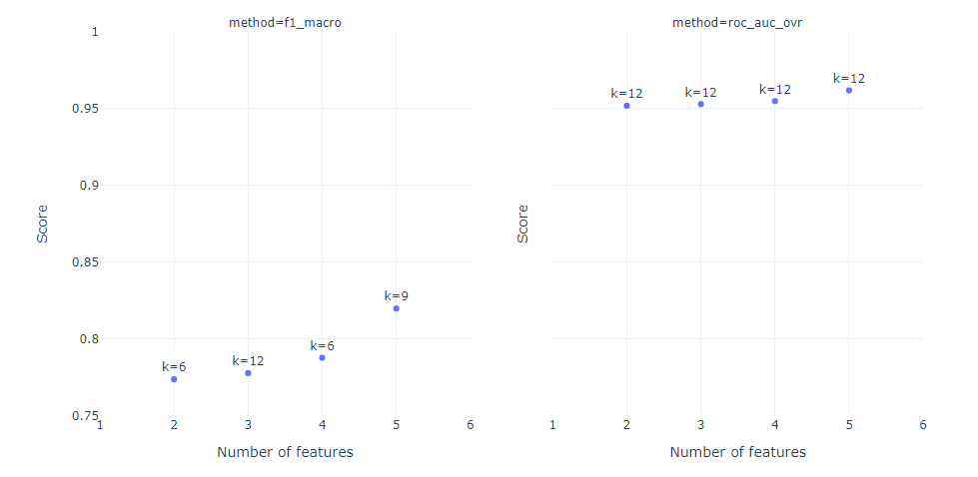
ModeL analysis

Slide 16
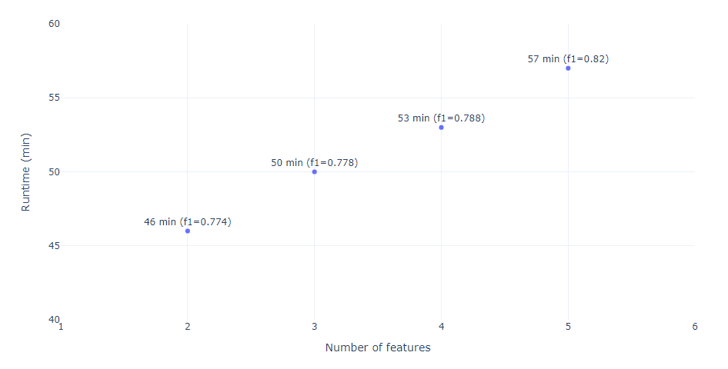
ModeL runtime

Slide 17
Best ModeL
5 features
k = 9 nearest neighbors
weights = distance
leaf size = 15

Slide 18
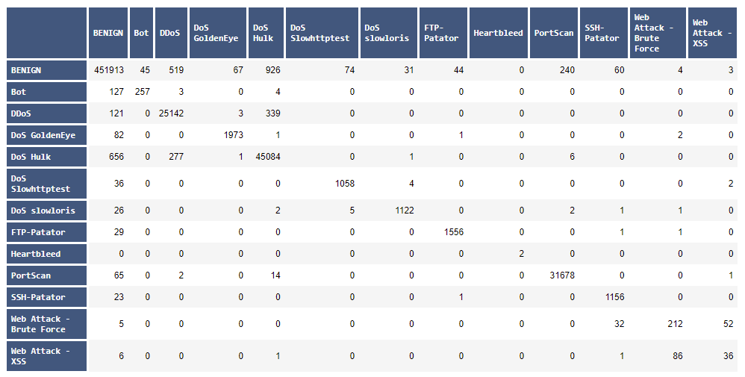
Confusion matrix

Slide 19
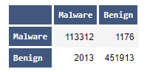
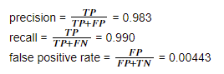
Confusion matrix (OVR)

Slide 20
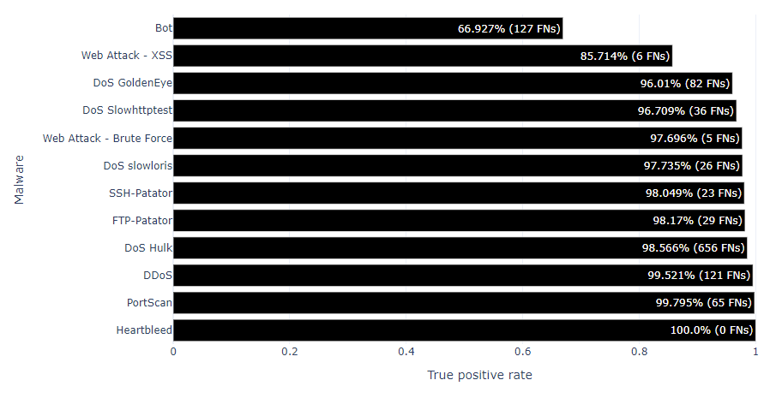
Hardest malware to identify

Slide 21
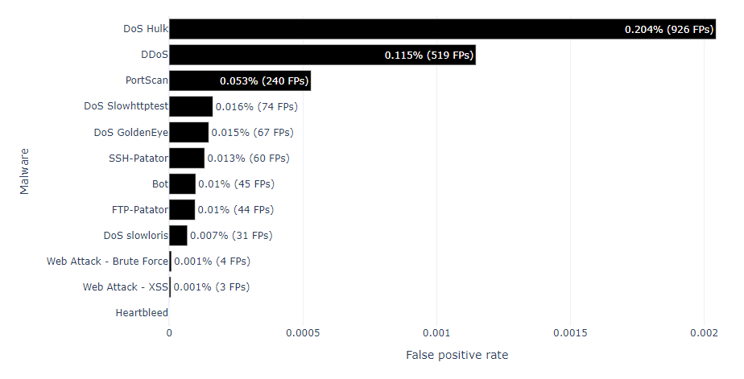
Malware most prone to false positives

Slide 22
conclusions
More features: better performance
More KNN neighbors: generally better
KNN produced very good results
Macro F1 = 82.0 %
Precision = 98.3 %
Recall = 99.0 %
False positive rate = 0.4 %

Slide 23
The downside
Performance vs speed
Not fast enough for real-time analysis
2.8M flow samples
=> 46 min (2 PCA features)
UW-Madison network: 30M samples / 5 min
=> 8.1 hours
Possible solutions:
Downsampling
Parallel processing

Slide 24
References
https://www.unb.ca/cic/datasets/ids-2017.html
https://www.activestate.com/resources/quick-reads/how-to-classify-data-in-python/
https://machinelearningmastery.com/calculate-principal-component-analysis-scratch-python/
https://muthu.co/understanding-the-classification-report-in-sklearn/
https://towardsdatascience.com/micro-macro-weighted-averages-of-f1-score-clearly-explained-b603420b292f
https://towardsdatascience.com/confusion-matrix-for-your-multi-class-machine-learning-model-ff9aa3bf7826
https://towardsdatascience.com/gridsearchcv-for-beginners-db48a90114ee
https://machinelearningmastery.com/tour-of-evaluation-metrics-for-imbalanced-classification/
https://towardsdatascience.com/comparative-study-on-classic-machine-learning-algorithms-24f9ff6ab222

